Slide 1


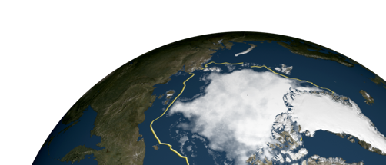

Satellite Remote Sensing Work
The International MOSAiC Consortium
Presented by Gunnar Spreen

Slide 2
Remote Sensing Research Questions
How well do satellite algorithms perform in the Central Arctic for parameters such as sea ice thickness distribution, snow depth, ice type, floe sizes, ice concentration, and ice drift and deformation?
Can co-located ground-based sea ice/snow, optical and microwave measurements help to develop improved satellite retrieval methods for ice area, thickness, melt pond parameters, albedo and snow depth?
Can satellite observations be used to upscale detailed regional information to pan-Arctic domains?

Slide 3
Three key areas involving remote sensing
Support of operations and scientific planning
Validation of remote sensing data
with field measurements
Collect a comprehensive EO
dataset for scientific analysis

Slide 4
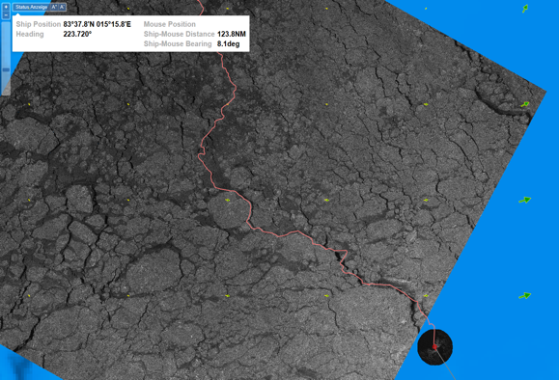
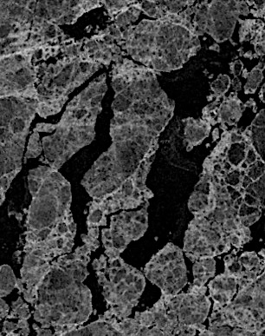
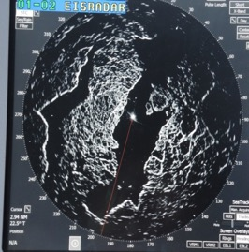
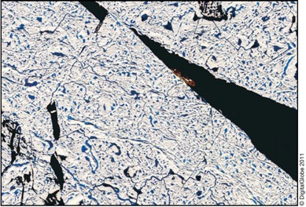
Scientific and Operational Planning
Getting Polarstern into the ice and finding the right floe
Support for supply cruises and aircraft operations
Layout of distributed network and buoy arrays
Datasets:
  high resolution SAR imagery
  ice drift with forecast
  sea ice concentration and type
  high resolution visual images
Ice radar on board
RV Polarstern
Geocoded TerraSAR-X L1b product
MapViewer on board of Polarstern
Contact: Gerchow/Krumpen
Worldview-2, 0.5m
Near-real time SAR data from DLR
Thomas Krumpen
Suman Singha

Slide 5

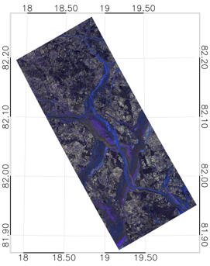
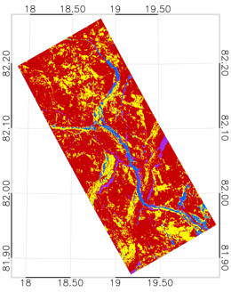
Sea Ice Classification
Develop a full seasonal operational sea ice classification for different frequencies
Combine a full season of SAR data with in-situ data for validation
  Helicopter-borne sea ice data; freeboard data, thickness data, photographs
Study the effect of the snow cover, its internal structures and melting on the satellite radar signature.
Use a multi-frequency approach, X, C and L-band SAR
Study different sea ice types, e.g. multi-year ice and first-year ice
Different frequencies have different sensitivity to;
  sea ice types
  sea ice thicknesses
  snow cover
  wetness
Using the ground based radars to monitor the structural changes within the snow pack
Ice classification
R. Ressel, S Singha, S. Lehner, A. Rösel and G. Spreen, “Near Real Time Automated Sea Ice Classification using Polarimetric TerraSAR-X Images”, IEEE Journal of Selected Topics in Applied Earth Observations and Remote Sensing, 2016
Open Water/Nilas
Smooth First Year Ice
Rough First Year/ Multi-Year Ice
Young Ice
Suman Singha
Gunnar Spreen

Slide 6
Validation of remote sensing data with field measurements
  MOSAiC provides ideal conditions for validation of satellite remote sensing observations:
    It is a rare case to observe the complete seasonal cycle including winter observations.
    The MOSAiC distributed grid of measurements covers the typical satellite footprint scales.
    The helicopter/aircraft campaigns will allow to bridge the gap between in situ and satellite observations.

Slide 7
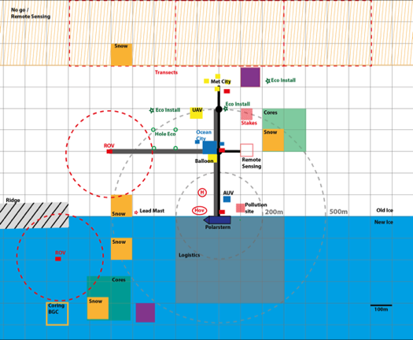
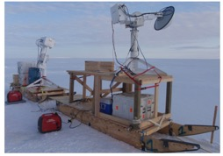
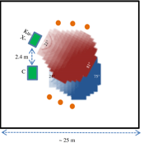
On Ice Measurements
Remote
sensing
validation site:
  Scatterometer
  Radiometer
  IR camera
  hyperspectral
  camera
  GNSS-R
monitor the same snow/ice surface
In-situ snow/ice properties measured close by
Specific requests?

Slide 8

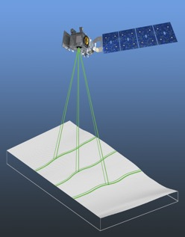
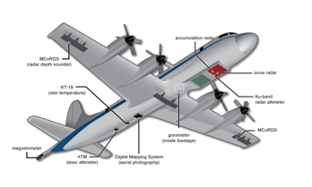

ICESat-2 Evaluation
Laser altimeter with
6 beams
In-situ measurements of ice and snow
Influence of snow and melt ponds on ICESat-2 retrieval
NASA Operation Icebridge overflight in 2020 planed
Melinda Webster
Ron Kwok

Slide 9
ESA endorsed activities overview
Microwave scatterometer (Lead PI: Gunnar Spreen, Bremen Univ.)
Microwave radiometer (Lead PI: Lars Kaleschke, Hamburg Univ)
Ku-Ka ground penetrating radar (Lead PI: Robert Ricker, AWI)
GNSS Reflectometry (Lead PI: Manuel Martin-Neira, ESA)
One birth (one scientist TBD) for one leg (ideally the first but TBC)
Possible CryoVEX/KAREN joint flights with AWI in Spring 2020 (TBC)

Slide 10


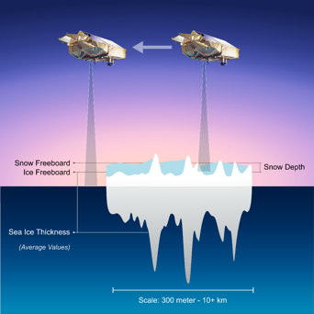
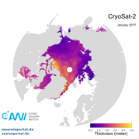
Sea Ice Radar Altimetry
CryoSat-2 | Sentinel-3 | ICESat-2
Altimeter validation
  Ice and snow thickness, properties, stratigraphy
  Surface topography and
  snow distribution
Ku/Ka band radar transects
  Snow penetration and scattering
Lead Range
Measurement
Sea Ice Range
Measurement
Ku/Ka band radar
Sea Ice Thickness
Robert Ricker
Julienne Stroeve
Notes:
Anna Hogg, Malcolm Davidson, Tânia Casal, Tommaso Parinello, Thomas Armitage, Robert Ricker, Stephan Hendricks, Julienne Stroeve, Sebastian Simonsen, Rene Forsberg

Slide 11
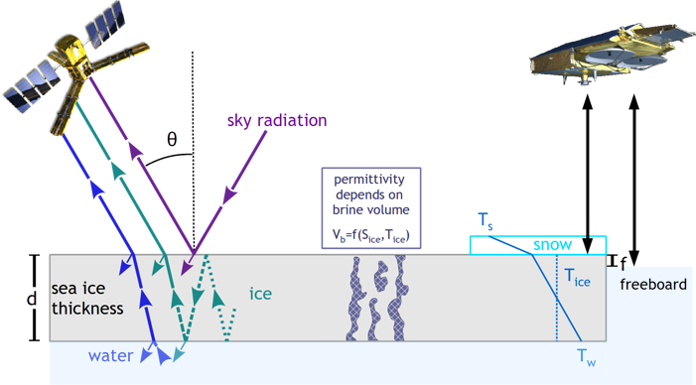
Sea ice thickness from SMOS and CryoSat2

Slide 12
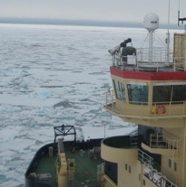
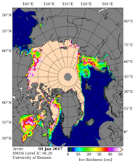
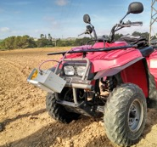
Microwave Radiometer
Evaluation of SMOS and SMAP thin ice and snow retrievals
Development of snow and ice radiative transfer model
Microwave radiometer
  L-band onboard or fixed on ice EMIRAD2
  Mobile P/L/C-band ARIEL system
Higher frequencies for ice concentration evaluation missing
EMIRAD
Thin Ice Thickness
ARIEL
Lars Kaleschke
Tânia Casal
Notes:
Microwave radiometer for, e.g., SMOS validation: seasonal cycle, snow and melt processes.
Lars Kaleschke, University of Hamburg, Germany
Carolina Gabarró, CSIC, Barcelona, Spain

Slide 13
Proposed measurements
EMIRAD/ELBARA 1.4 GHz radiometer on Polarstern or on platform
  Continuous operation with regular calibrations
  Fixed incidence angle (45°)
  Thermal infrared + camera
ARIEL multi-frequency radiometer on a sledge
  Multi-frequencies: 0.5, 1.4, 7 GHz
  Weekly transects co-located with in-situ measurements
  Validation/comparison with EMIRAD2/ELBARA
Coordinated with airborne and satellite measurements
Time period October-May

Slide 14
What are the expected outcomes?
Measurements of the brightness temperature at multiple frequencies for snow covered ice across a long period of time under varying environmental conditions;
Spatial variability of brightness temperatures
Validation of RT models using collocated measurements from remote sensing and in-situ
Improved sea ice emissivity / radiative transfer models
Improved retrieval algorithms for sea ice and snow thickness for L-band missions
New retrieval methods (e.g. for sea ice salinity) for
future satellite missions

Slide 15
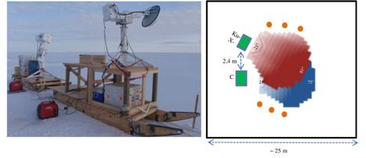
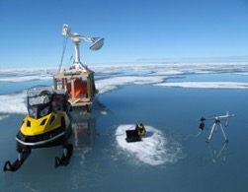
Microwave Scatterometer
Evaluation of SAR (Sentinel-1, TerraSAR-X, Radarsat-2, ALOS-2) and scatterometers (ASCAT)
Multi-frequency (L/C/X/Ku), polarimetric scatterometer measurements snow and ice
Snow and ice radiative transfer and scattering model
Extensive in-situ snow and ice properties measurements
Thin Ice Thickness
Claude Duguay
University of Waterloo
Randall Scharien
University of Victoria
John Yackel
University of Calgary
Gunnar Spreen
Tânia Casal
Notes:
Gunnar Spreen¹, Claude R. Duguay², Randall Scharien³, John Yackel⁴, Christian Haas⁵, Marcus Huntemann^{1,5}, Lars Kaleschke⁶, Ghislain Picard⁷, Nick Rutter⁸, Melody Sandells⁹
¹University of Bremen, ²University of Waterloo, ³University of Victoria, ⁴University of Calgary, ⁵Alfred Wegener Institute, ⁶University of Hamburg, ⁷Institut des Géosciences de l'Environnement, ⁸Northumbria University, ⁹CORES Science and Engineering Limited

Slide 16
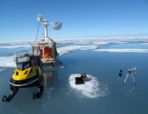
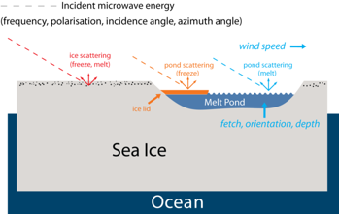


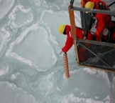
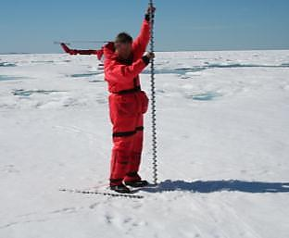
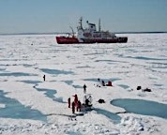
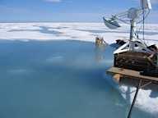
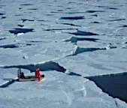
Randy Scharien, University of Victoria
MOSAiC-Scat
Project. Better understanding of radar interaction with various sea ice features during sea ice melt pond season
Multi-frequency, polarimetric scatterometer measurements of key features
Surface roughness and dielectric property measurements/estimates
Scaling up and validating satellite data using aircraft and UAV data

Slide 17

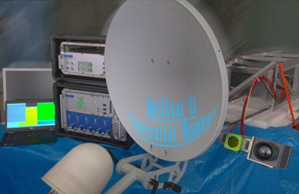
HeliScat II – Helicopter Radar Scatterometer
Repeated Helicopter flights over pre-defined pattern.
Ideally in constellation with ground measurements and EM-bird
Measured parameters: snow and ice parameters at 5 frequencies (L – Ku), 4 polarizations (HH, VV, HV, VH) and several incident angles.
Measurements synchronic with video and infrared recordings from same footprint.
HeliScat II system modules/components
There are several additional instruments to supplement the backscatter data sets acquired during flights. These data are stored synchronous to the scatterometer acquisition: (1) Visible and (2) IR (Infra Red) high resolution image streams covering the scatterometer footprint;
(3) an X-sense motion tracker captures all helicopter move-ments (pitch, roll, yaw);
(4) GPS is used to register the helicopter position and time (LAT, LON, ALT, UTC). (5) A powerful servo drive allows to adjust the antenna angle and dynamically compensate the helicopter pitch motion.
Finally, the complete system can be operated from a laptop.
(5)
(4)
(3)
(1)
(2)
Fig. 4: The new HeliScat II: (1) visible and (2) IR cameras, (3) antenna, (4) mounting rack for helicopter use, (5) antenna drive/cam unit (above) and microwave unit (below).

Slide 18
GNSS-R Sensor Accommodation
Proposed by M. Martin-Neira (ESA) and Estel Cardellach (Institute of Space Sciences, Barcelona)
GNSS-R Electronics to be installed in an inner room of the boat
GNSS-R Antennas to be installed over the bridge (see next slides)
Distance between Electronics and Antennas < 10 m
GNSS-R Antennas
(2 flat antennas of 50 cm x 25 cm x 2 cm +
1 standard GNSS antenna)
GNSS-R Electronics
(in standard 19-inch rack x 70 cm high + laptop)
Notes:
Our final conclusion is that the
operators would need to intervene only a few times during the 1 year campaign
. The final frequency of interventions will depend on the possibility to send
data through any internet-like communications link. Otherwise, the operators will need to replace
disks once they are full (this could be a few times during the campaign,
every few months--TBC).

Slide 19


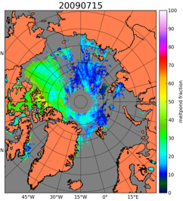
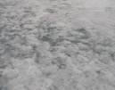

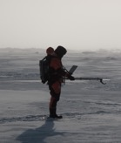
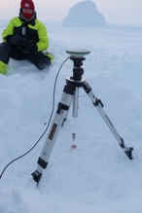
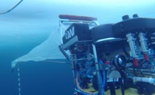
Optical Measurements
Melt Pond Fraction
Thin Ice Thickness
MODIS, Sentinel-3, VIIRS medium and Sentinel-2, Landsat Pleiades high resolution
Optical properties of snow and sea ice
  Melt ponds
  Albedo
  Snow melt
Spectrometer
Hyperspectral Camera
ROV
Photo: M. Nicolaus
Photo: AWI Meereisphysik
Natascha Oppelt
Larysa Istomina
Notes:
Lars Kaleschke, University of Hamburg, Germany
Carolina Gabarró, CSIC, Barcelona, Spain

Slide 20

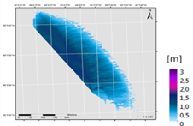
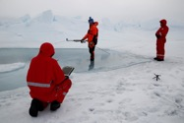
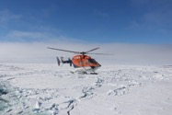
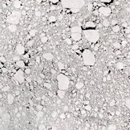
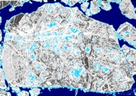
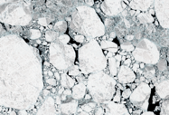
Uni Kiel – Main topics
Scaling in situ, airborne and satellite data to develop remote sensing based algorithms for melt pond monitoring
  Water constituents (mainly Chl-a)
  Pond extend and depth
  Directional reflectance properties of sea ice
  Accuracy assessment
Cal/val of airborne and satellite data
Parametrisation of atmospheric correction (low sun altitudes) and bio-optical models (diffuse light, pond bottom)
Mapping of floes
Water depth modelling based on AISA data (Meltex II)
(Floe mapping based on S2-A July 2017)
deep water / lead
pond / ice edge
deep snow
shallow snow
ridge
Natascha Oppelt
Gerit Birnbaum

Slide 21
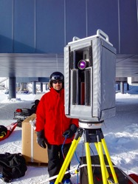
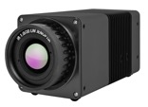


IR & Hyperspectral Camera
Photo: Adam LeWinter
Infrared camera InfraTec
  0.03 K precision, 2 K accuracy
Hyperspectral camera
  400–1000 nm
  Internal line-scanner camera
Deployed at remote sensing validation site
Monitor specific events
  Thin ice in new leads
  Melt pond development
Infrared Camera
Hyperspectral Camera

Slide 22
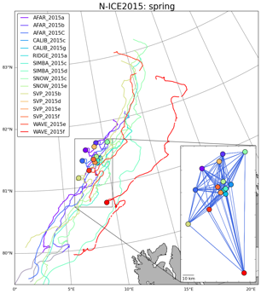
Sea Ice Dynamics
Sea ice drift and deformation from SAR
Buoy array
Ship radar
Jenny Hutchings
Jari Haapala
Anton Korosov
Polona Itkin

Slide 23

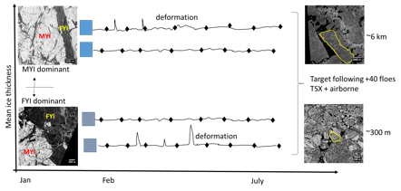
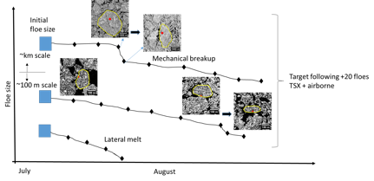
Floe-scale observation and quantification of Arctic sea ice breakup and floe size during the winter-to-summer transition (MOSAiCFSD)
Remote Sensing
TerraSAR-X:
Winter (Autumn to Spring Breakup): StripMap (~30x50 km) acquisition at ~7 day interval at the MOSAiC site; the collected data will be used to retrieve leads/cracks and ice type.
Summer (Spring Breakup to Summer): StripMap (~30x50 km) acquisition at ~3 day interval at the three Summer Floe Sites; the collected data will be used to retrieve the floe size of each target floe as well as statistical floe size distribution of the image area.
Sentinel-1:
We also plan to analyse Sentinel-1 data to derive winter leads/cracks and ice type at the MOSAiC site, as well as floe size distribution in summer.
Winter Transition – Leads/Cracks
Summer Transition – Floe size distribution
Phil Hwang

Slide 24
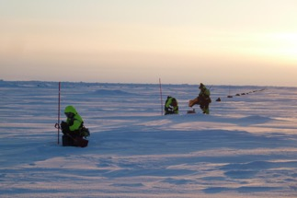
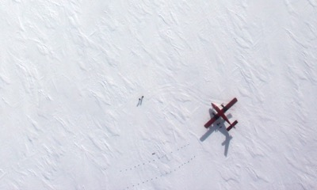
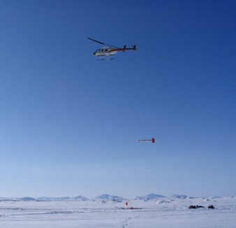
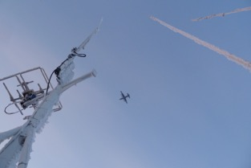
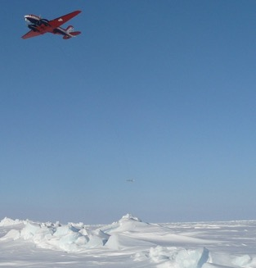
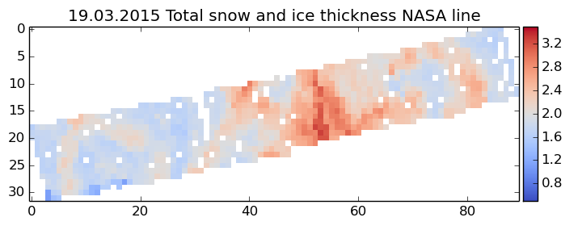
Airborne Campaign
Airborne campaigns
important for validation
  Polar-5/6
  helicopter onboard
  NASA Operation IceBridge
  ESA CryoVal
Grid measurements for
better comparison
Satellite underflights
  CryoSat-2, SMOS
  ICESat-2 can point to MOSAiC
  Sentinel-1,3 and TerraSAR-X
Operation IceBridge
ESA CryoVex
Andreas Herber
Gerit Birnbaum
Notes:
HALO
BAS Twin Otter

Slide 25



CryoVex/KAREN 2020? Possible joint flights with AWI
CryoVEx/KAREN 2017
Objectives
Verify upgraded CryoSat L1 and L2 processors
Support assessment of Ka- and Ku-band altimetric mission concept
Campaign details
DTU Space (DK), AWI (DE), BAS (UK), Leeds Univ. (UK) and MetaSensing (NL)
First full-scale campaign flying a Ku-Ka band radar simultaneously
Sea & land ice measurements (airborne & ground) in Mar/Apr 2017
Ku-Band: ASIRAS
Ka-Band: KAREN

Slide 26
Satellite Data Overview
SAR/Scatterometers ice type, ice drift |  | Altimeters ice thickness, (snow depth) |  | Radiometers ice area, ice drift, ice thick., snow |  | Optical melt ponds, leads, floe size albedo, surface temp. |  | Lidar/cloud radar aerosols, cloud properties, wind |  | Atmosphere water vapor, surfaces and TOA fluxes, gases
Satellite/Sensor | Resol. | Satellite/ Sensor | Resol. | Satellite/ Sensor | Resol. | Satellite/ Sensor | Resolution | Satellite | Parameter | Satellite/ Sensor | Resol.
Sentinel-1 | 90 m | CryoSat-2 | 0.3 x 1.7 km | AMSR-2 | 4–47 km | MODIS | 250 m–1 km | CALIPSO | aerosols/ clouds | AIRS | 13–30 km
Radarsat-2/RCM | 3–100 m | ICESat-2 | 10 m | SSMIS | 14–54 km | VIIRS | 375–750 m | CloudSat | clouds | CrIS | 14 km
ALOS-2 (PALSAR-2) | 3–100 m | SRAL (Sentinel-3) | 0.3 x 1.6 km | SMOS | 40 km | OLCI, SLSTR (Sentinel-3) | 300 m– 1 km | EarthCARE | aerosols/ clouds | IASI | 12 km
TerraSAR-X | 1–40 m | SARAL/Altika | 1.4 km | SMAP | 40 km | AVHRR | 1.1 km | AEOLUS | wind | GOSAT | 0.5–1.5 km
TanDEM-X | 12–30 m |  |  |  |  | Sentinel-2 | 10–60 m |  |  | OCO-2 | 10.6 km
COSMO-SkyMed | 1–100 m |  |  |  |  | Landsat 8 | 30–100 m |  |  | CERES | 20 km
SAOCOM | 10–100 m |  |  |  |  | Pléiades | 0.5–2 m |  |  | GOME-2 | 20 km
ASCAT | 25 km |  |  |  |  |  |  |  |  | Sentinel-5P | 7 km
 |  |  |  |  |  |  |  |  |  | AMSU-A | 48 km
 |  |  |  |  |  |  |  |  |  | MHS | 17 km
  Red: needs ordering/coordination; Green: support confirmed; Grey: stops at ~82°N; Italic: not launched yet
A large archive of satellite data for future analysis will be created
  For some satellites support already confirmed
  Need points of contact for other missions
  Data sharing is important

